Slide 1
Early responders to semaglutide 7.2 mg: A post hoc analysis of the STEP UP trial in adults with obesity
Dr. Alfonso Bosco presenting on behalf of all authors
Dror Dicker¹, Deborah B. Horn², Christine S. Fuchs Jacobsen³, Swathi Gopal⁴, Maria Quiroga³, Sean Wharton⁵
¹Internal Medicine Department D and Obesity Clinic, Rabin Medical Center, Hasharon Hospital, Petah Tiqva, and Gray Faculty of Medicine & Health Sciences, Tel Aviv University, Tel Aviv, Israel; ²Center for Obesity Medicine and Metabolic Performance, Departments of Internal Medicine and Surgery, University of Texas McGovern Medical School, Houston, TX, USA; ³Novo Nordisk A/S, Søborg, Denmark; ⁴Novo Nordisk Global Business Services, Bangalore, India; ⁵University of Toronto, Toronto, Ontario, Canada

Slide 2
Introduction
Individual responses to obesity medications vary considerably^{1,2}
The clinical implications of rapid and pronounced body weight reduction with obesity medications remain unclear, and there is no clinical consensus on what defines an early response
In STEP UP, once-weekly s.c. semaglutide 7.2 mg treatment led to a significantly greater mean body weight reduction of 20.7% vs semaglutide 2.4 mg (17.5%; p<0.0001) or vs placebo (2.4%; p<0.0001), after 72 weeks in participants with obesity†³
This post hoc analysis of STEP UP evaluated the effects of an early response to treatment on overall body weight reduction
s.c., subcutaneous.
†Using the efficacy estimand (previously referred to as the ‘trial product estimand’).
1. Webster CM et al. Obes Rev 2023;24:e13568; 2. Squire P et al. BMJ Open 2025;15:e089477; 3. Wharton S et al. Lancet Diabetes Endocrinol 2025;13:949‒963.

Slide 3
STEP UP trial design¹
Phase 3b randomised, double-blind, placebo- and active-controlled, multinational trial (NCT05646706)
Once-weekly s.c. dose-matched placebo (n=201)
Once-weekly s.c. semaglutide 7.2 mg (n=1005)
Once-weekly s.c. semaglutide 2.4 mg (n=201)
Dose escalation
7.2 mg
Off-treatment follow-up
1.7 mg
2.4 mg
1.0 mg
2.4 mg
Off-treatment follow-up
0.25 mg
0.5 mg
1.7 mg
N=1407
(5:1:1)
0.5 mg
1.0 mg
0.25 mg
Off-treatment follow-up
Lifestyle intervention: –500 kcal/day diet + ≥150 min/week physical activity
Week –1
Screening
Week 0
Randomisation
Week 20
End of dose escalation
Week 72
End of treatment
Week 81
End of trial
Population
Adults (aged ≥18 years)
BMI ≥30 kg/m²
≥1 self-reported unsuccessful
dietary effort to lose weight
Without T2D (HbA_{1c} <6.5%)
Co-primary and key confirmatory secondary endpoints at week 72
Percentage change in body weight (semaglutide 7.2 mg vs placebo; co-primary)
Proportion of participants with ≥5% (co-primary), ≥10%, ≥15%, ≥20% and ≥25% body weight reduction (semaglutide 7.2 mg vs placebo)
Percentage change in body weight (semaglutide 7.2 mg vs 2.4 mg)
Proportion of participants with ≥20% and ≥25% body weight reduction (semaglutide 7.2 mg vs 2.4 mg)
Sections of this figure have been reproduced from Wharton S et al 2025² by permission from the American Diabetes Association.
BMI, body mass index; HbA_{1c} , glycated haemoglobin; s.c., subcutaneous; T2D, type 2 diabetes.
1. Wharton S et al. Lancet Diabetes Endocrinol 2025;13:949‒963; 2. Wharton S et al. Diabetes 2025;74(suppl 1):1966–LB.
3
Notes:
Trial design and participants
STEP UP was a phase 3b, three-armed trial that compared semaglutide 7.2 mg with semaglutide 2.4 mg and placebo in 1407 participants with obesity
People with a history of diabetes, an HbA_{1c} ≥6.5% (48 mmol/mol) or a self-reported change in body weight of >5 kg in the 90 days before screening were excluded
The trial was conducted across 95 sites in 11 countries (Bulgaria, Canada, Germany, Greece, Hungary, Norway, Poland, Portugal, Slovakia, South Africa, and the USA)
Procedures
Participants in the two semaglutide groups started on 0.25 mg once weekly and escalated to 2.4 mg over 16 weeks; at week 20, those in the 7.2 mg group escalated directly to this dose without further titration
A delay to dose escalation, or dose reduction, was allowed if the participant was unable to tolerate the 2.4 mg or 7.2 mg maintenance dose and would otherwise discontinue treatment
However, it was recommended that each participant made at least one attempt to re-escalate before staying on a lower dose
The treatment period was 72 weeks in total, followed by a 9-week off-treatment follow-up period
Participants also underwent lifestyle intervention, which consisted of a reduced-calorie diet and increased physical activity
Outcomes
There were two co-primary endpoints: percentage change in body weight and attainment of ≥5% body weight reduction
Changes in CoEQ and TFEQ-R18v2 scores were prespecified exploratory endpoints

Slide 4
Methods
Early responders and responders were defined post hoc:
Early responders: ≥15% body weight reduction by week 24†
Responders: <15% body weight reduction by week 24
Partecipants
Missing body weight assessments at week 24 were estimated using an MMRM
Proportions of early responders and responders were described for the on-treatment period, along with the trajectory of body weight reduction from baseline to week 72 by treatment group and responder status
Body weight changes (% and kg) during the in-trial period were estimated using the treatment regimen estimand‡
Week 72 responses were analysed using an ANCOVA model with BMI category (≥35 vs <35 kg/m2), sex, prediabetes status and randomised treatment as factors, and baseline body weight as covariate
The safety profile of each group was also assessed
Analysis
†This definition was based on a post hoc analysis of the SURMOUNT-5 trial.¹ ‡Previously referred to as the ‘treatment policy estimand’.
ANCOVA, analysis of covariance; BMI, body mass index; MMRM, mixed model for repeated measures.
1. Aronne LJ et al. Am J Med 2026;doi:10.1016/j.amjmed.2026.03.010 [online ahead of print].

Slide 5
Baseline demographics
 | Semaglutide 7.2 mg (n=1005) |  | Semaglutide 2.4 mg (n=201) |  | Placebo (n=201)
Parameter | Early responders | Responders | Early responders | Responders | Early responders | Responders
Participants, n (%) | 270 (26.9) | 735 (73.1) | 42 (20.9) | 159 (79.1) | 6 (3.0) | 195 (97.0)
Age, years, mean (SD) | 46 (13) | 48 (12) | 46 (12) | 47 (12) | 45 (15) | 48 (12)
Sex, n (%)
Female | 216 (80.0) | 537 (73.1) | 33 (78.6) | 104 (65.4) | 5 (83.3) | 142 (72.8)
Male | 54 (20.0) | 198 (26.9) | 9 (21.4) | 55 (34.6) | 1 (16.7) | 53 (27.2)
Race, n (%)
American Indian / Alaska Native | 0 | 0 | 0 | 0 | 0 | 3 (1.5)
Asian | 10 (3.7) | 42 (5.7) | 1 (2.4) | 3 (1.9) | 0 | 7 (3.6)
Black / African American | 14 (5.2) | 68 (9.3) | 3 (7.1) | 14 (8.8) | 0 | 22 (11.3)
Native Hawaiian / Other Pacific Islander | 0 | 1 (0.1) | 0 | 2 (1.3) | 0 | 0
White | 243 (90.0) | 616 (83.8) | 38 (90.5) | 138 (86.8) | 6 (100) | 162 (83.1)
Multiple | 3 (1.1) | 6 (0.8) | 0 | 1 (0.6) | 0 | 1 (0.5)
Missing | 0 | 2 (0.3) | 0 | 1 (0.6) | 0 | 0
Ethnicity, n (%)
Hispanic / Latino | 10 (3.7) | 34 (4.6) | 2 (4.8) | 10 (6.3) | 1 (16.7) | 6 (3.1)
Not Hispanic / Latino | 260 (96.3) | 701 (95.4) | 40 (95.2) | 149 (93.7) | 5 (83.3) | 189 (96.9)
Percentages are based on number of participants.
SD, standard deviation.
5

Slide 6
Baseline clinical characteristics
 | Semaglutide 7.2 mg (n=1005) |  | Semaglutide 2.4 mg (n=201) |  | Placebo (n=201)
Parameter | Early responders | Responders | Early responders | Responders | Early responders | Responders
Participants, n (%) | 270 (26.9) | 735 (73.1) | 42 (20.9) | 159 (79.1) | 6 (3.0) | 195 (97.0)
Body weight, kg, mean (SD) | 104.3 (19.9) | 115.4 (24.5) | 104.5 (19.1) | 119.7 (26.9) | 105.0 (9.3) | 112.7 (23.0)
BMI, kg/m², mean (SD) | 37.3 (5.5) | 40.7 (7.3) | 37.8 (6.4) | 41.2 (8.0) | 36.8 (3.9) | 39.8 (6.7)
Waist circumference, cm, mean (SD) | 112.9 (14.5) | 120.5 (15.7) | 114.2 (15.0) | 121.9 (17.1) | 108.0 (12.6) | 118.9 (14.4)
HbA_{1c}, %, mean (SD) | 5.6 (0.3) | 5.7 (0.3) | 5.6 (0.4) | 5.6 (0.3) | 5.5 (0.4) | 5.7 (0.3)
Glycaemic category, n (%)
Normoglycaemia | 171 (63.3) | 456 (62.0) | 33 (78.6) | 99 (62.3) | 5 (83.3) | 113 (57.9)†
Prediabetes | 99 (36.7) | 279 (38.0) | 9 (21.4) | 60 (37.7) | 1 (16.7) | 81 (41.5)†
Percentages are based on number of participants.
†Glycaemic category was evaluated in 194 participants in the placebo responder group, based on available information.
BMI, body mass index; HbA_{1c}, glycated haemoglobin; SD, standard deviation.
6

Slide 7
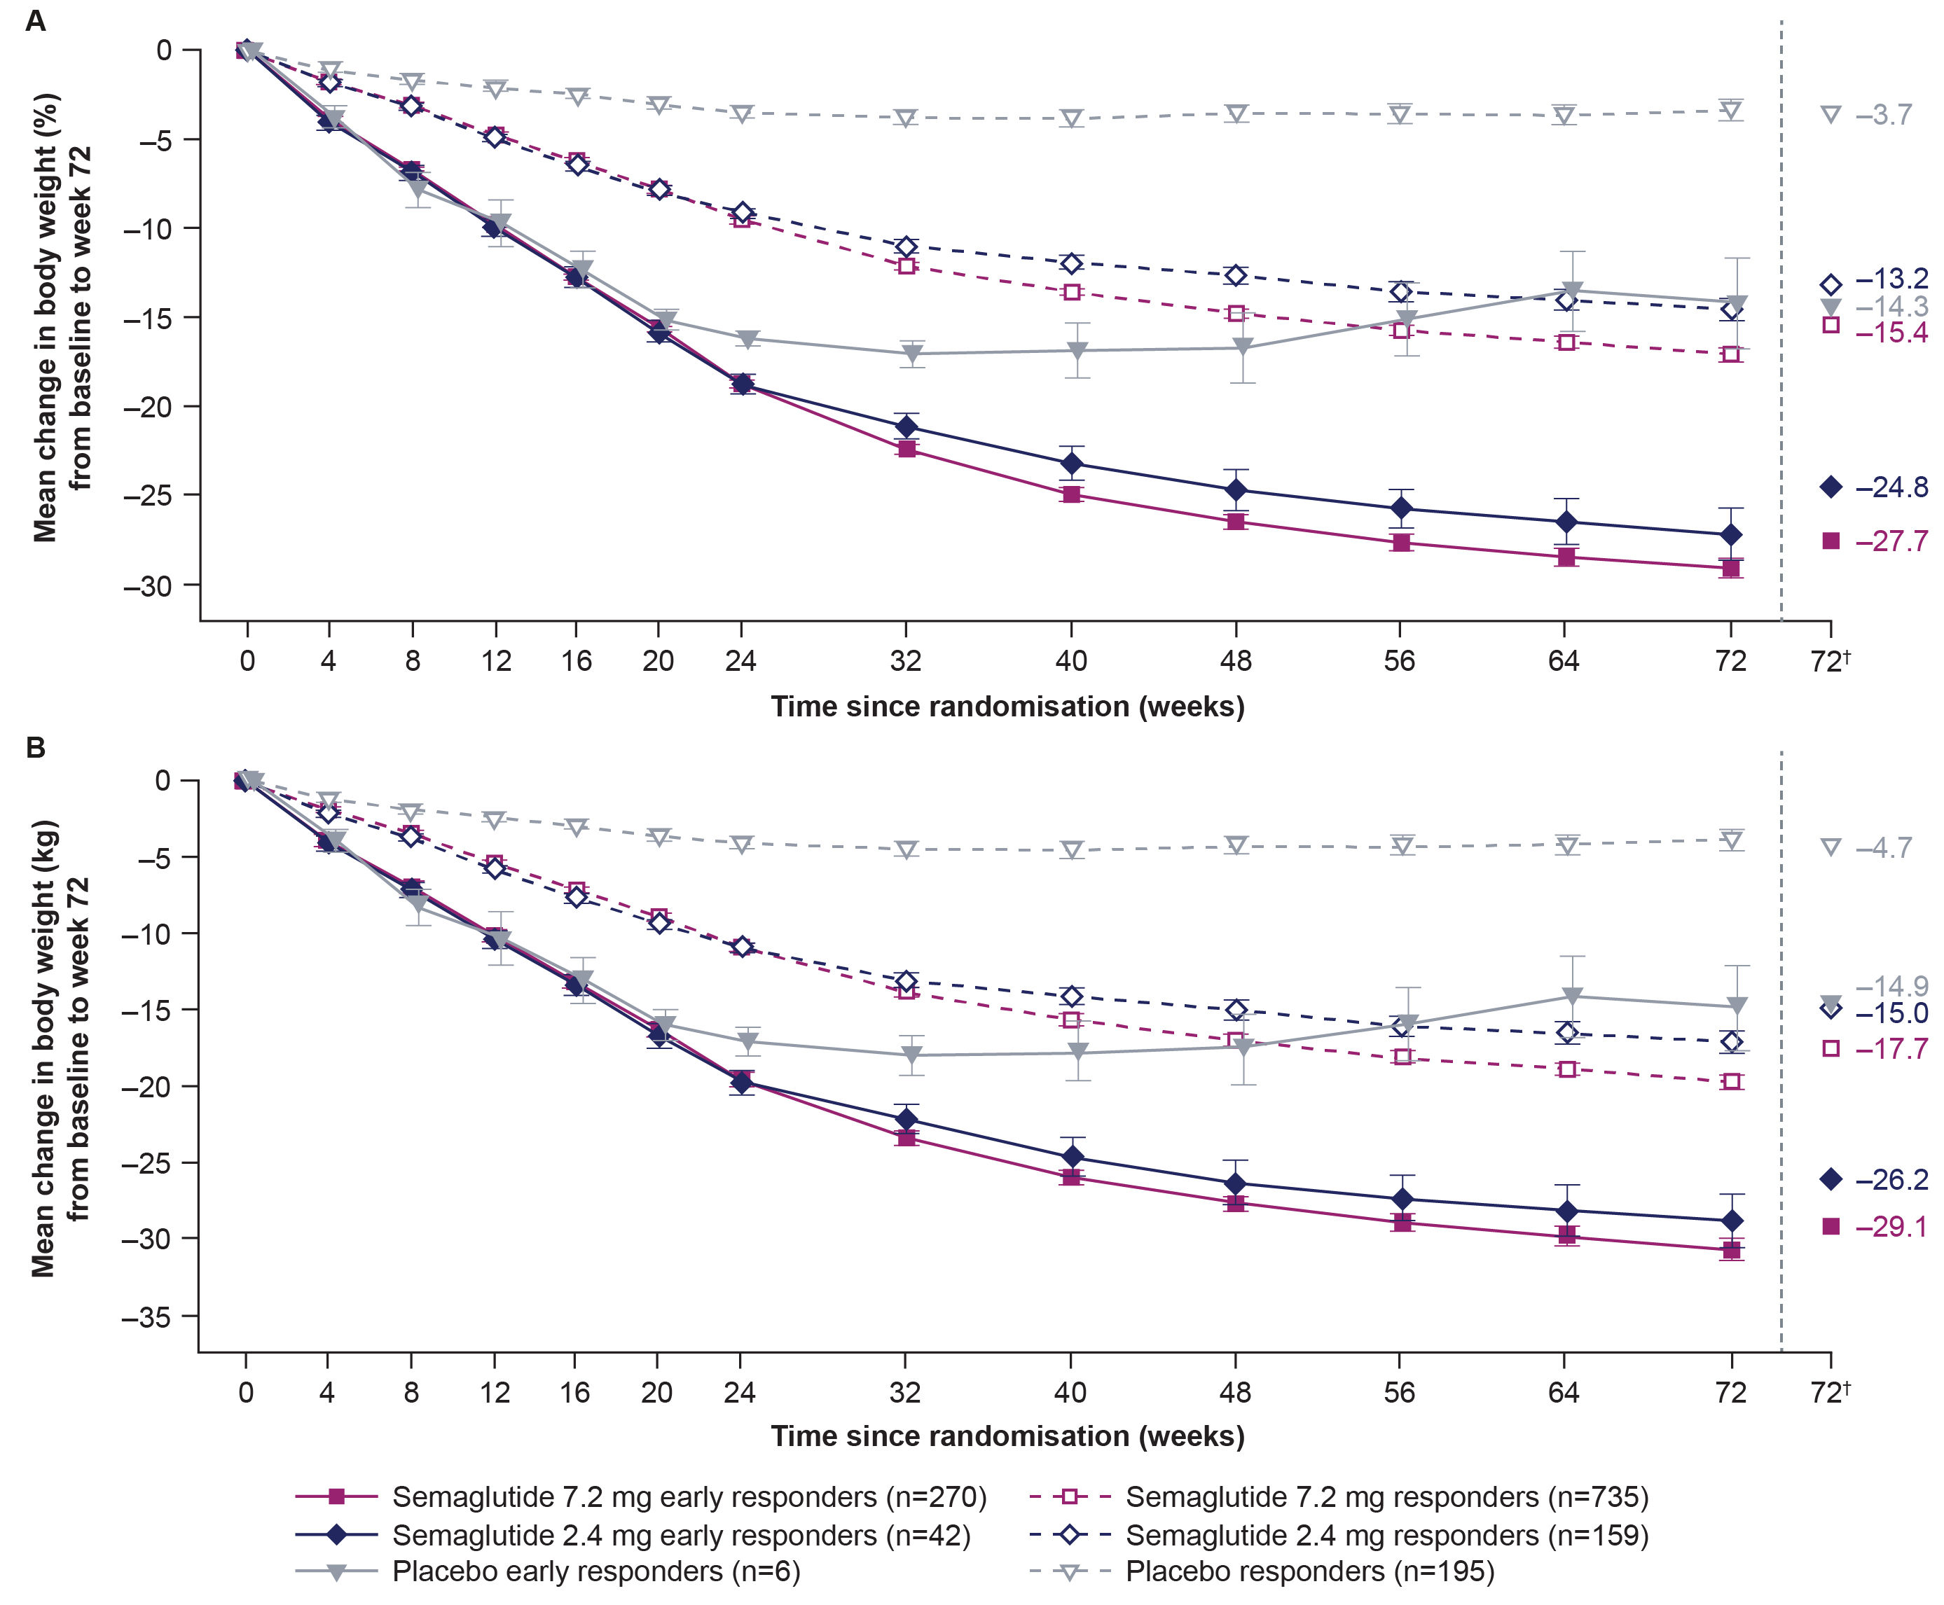
Change (%) in body weight from baseline to week 72 for early responders and responders
Mean change in body weight (%)
0
Change from baseline (%)
–5
–3.7%
–10
–13.2%
–15
–14.3%
p_{interaction}=0.647
–15.4%
–20
–25
–24.8%
–27.7%
–30
There were no significant interactions between the semaglutide dose and responder status for overall mean change (%) in body weight
0
4
8
12
16
20
24
32
40
48
56
64
72
72†
Time since randomisation (weeks)
Early responders: ≥15% weight loss at week 24
Responders: <15% weight loss at week 24
Semaglutide 7.2 mg early responders (n=270)
Semaglutide 7.2 mg responders (n=735)
Semaglutide 2.4 mg early responders (n=42)
Semaglutide 2.4 mg responders (n=159)
Placebo early responders (n=6)
Placebo responders (n=195)
Observed data are from the on-treatment period. Error bars are ± standard error of the mean.
†Estimated means using the treatment regimen estimand (previously referred to as the ‘treatment policy estimand’).
7

Slide 8
Change (kg) in body weight from baseline to week 72 for early responders and responders
Mean change in body weight (kg)
0
Change from baseline (kg)
–5
–4.7 kg
–10
–14.9 kg
–15
–15.0 kg
–17.7 kg
p_{interaction}=0.888
–20
–25
–26.2 kg
–30
–29.1 kg
–35
There were no significant interactions between the semaglutide dose and responder status for overall mean change (kg) in body weight
0
4
8
12
16
20
24
32
40
48
56
64
72
72†
Time since randomisation (weeks)
Early responders: ≥15% weight loss at week 24
Responders: <15% weight loss at week 24
Semaglutide 7.2 mg early responders (n=270)
Semaglutide 7.2 mg responders (n=735)
Semaglutide 2.4 mg early responders (n=42)
Semaglutide 2.4 mg responders (n=159)
Placebo early responders (n=6)
Placebo responders (n=195)
Observed data are from the on-treatment period. Error bars are ± standard error of the mean.
†Estimated means using the treatment regimen estimand (previously referred to as the ‘treatment policy estimand’).
8

Slide 9
Overview of AEs
Parameter | Semaglutide 7.2 mg |  |  |  |  |  |  |  | Semaglutide 2.4 mg |  |  |  |  |  |  |  | Placebo
 | Early responders |  |  |  | Responders |  |  |  | Early responders |  |  |  | Responders |  |  |  | Early responders |  |  |  | Responders
 | n | % | E | R | n | % | E | R | n | % | E | R | n | % | E | R | n | % | E | R | n | % | E | R
Participants, n | 270 |  |  |  | 734 |  |  |  | 42 |  |  |  | 159 |  |  |  | 6 |  |  |  | 195
Patient-years of exposure | 398.0 |  |  |  | 1068.7 |  |  |  | 60.3 |  |  |  | 231.1 |  |  |  | 9.2 |  |  |  | 256.9
AEs | 246 | 91.1 | 2065 | 518.8 | 632 | 86.1 | 4298 | 402.2 | 39 | 92.9 | 245 | 406.4 | 130 | 81.8 | 881 | 381.1 | 4 | 66.7 | 11 | 119.5 | 152 | 77.9 | 699 | 272.1
Serious AEs
Yes | 22 | 8.1 | 29 | 7.3 | 46 | 6.3 | 62 | 5.8 | 2 | 4.8 | 3 | 5.0 | 20 | 12.6 | 27 | 11.7 | 0 |  |  |  | 11 | 5.6 | 16 | 6.2
No | 246 | 91.1 | 2036 | 511.5 | 624 | 85.0 | 4236 | 396.4 | 39 | 92.9 | 242 | 401.4 | 128 | 80.5 | 854 | 369.5 | 4 | 66.7 | 11 | 119.5 | 150 | 76.9 | 683 | 265.9
Severity
Severe | 27 | 10.0 | 42 | 10.6 | 54 | 7.4 | 108 | 10.1 | 5 | 11.9 | 11 | 18.2 | 16 | 10.1 | 30 | 13.0 | 0 |  |  |  | 9 | 4.6 | 15 | 5.8
Moderate | 158 | 58.5 | 598 | 150.2 | 348 | 47.4 | 1172 | 109.7 | 22 | 52.4 | 81 | 134.4 | 75 | 47.2 | 219 | 94.7 | 2 | 33.3 | 4 | 43.5 | 71 | 36.4 | 179 | 69.7
Mild | 230 | 85.2 | 1425 | 358.0 | 575 | 78.3 | 3017 | 282.3 | 34 | 81.0 | 153 | 253.8 | 120 | 75.5 | 632 | 273.4 | 2 | 33.3 | 7 | 76.0 | 134 | 68.7 | 505 | 196.6
AEs leading to:
Permanent treatment discontinuation | 11 | 4.1 | 22 | 5.5 | 43 | 5.9 | 57 | 5.3 | 4 | 9.5 | 6 | 10.0 | 4 | 2.5 | 4 | 1.7 | 0 |  |  |  | 2 | 1.0 | 2 | 0.8
Temporary discontinuation of trial product | 37 | 13.7 | 91 | 22.9 | 71 | 9.7 | 142 | 13.3 | 5 | 11.9 | 7 | 11.6 | 13 | 8.2 | 28 | 12.1 | 1 | 16.7 | 2 | 21.7 | 7 | 3.6 | 9 | 3.5
Dose reduction of trial product | 72 | 26.7 | 152 | 38.2 | 114 | 15.5 | 234 | 21.9 | 9 | 21.4 | 15 | 24.9 | 16 | 10.1 | 33 | 14.3 | 0 |  |  |  | 1 | 0.5 | 1 | 0.4
Death | 0 |  |  |  | 0 |  |  |  | 0 |  |  |  | 0 |  |  |  | 0 |  |  |  | 0
AEs with onset during the on-treatment period are shown for the safety analysis set (all exposed participants). A time point is considered as on treatment if any dose of trial product was administered within the prior 63 days.
n, number of participants experiencing at least one event; %, percentage of participants experiencing at least one event; E, number of events; R, event rate per 100 years; AE, adverse event.
9

Slide 10
Most common AEs
Parameter | Semaglutide 7.2 mg |  |  |  |  |  |  |  | Semaglutide 2.4 mg |  |  |  |  |  |  |  | Placebo
 | Early responders |  |  |  | Responders |  |  |  | Early responders |  |  |  | Responders |  |  |  | Early responders |  |  |  | Responders
 | n | % | E | R | n | % | E | R | n | % | E | R | n | % | E | R | n | % | E | R | n | % | E | R
Participants, n | 270 |  |  |  | 734 |  |  |  | 42 |  |  |  | 159 |  |  |  | 6 |  |  |  | 195
GI disorders | 207 | 76.7 | 1046 | 262.8 | 504 | 68.7 | 2013 | 188.4 | 32 | 76.2 | 103 | 170.9 | 91 | 57.2 | 376 | 162.7 | 3 | 50.0 | 4 | 43.5 | 83 | 42.6 | 214 | 83.3
Nausea | 136 | 50.4 | 345 | 86.7 | 303 | 41.3 | 561 | 52.5 | 17 | 40.5 | 23 | 38.2 | 60 | 37.7 | 125 | 54.1 | 1 | 16.7 | 1 | 10.9 | 25 | 12.8 | 38 | 14.8
Vomiting | 93 | 34.4 | 216 | 54.3 | 156 | 21.3 | 309 | 28.9 | 6 | 14.3 | 13 | 21.6 | 27 | 17.0 | 52 | 22.5 | 0 |  |  |  | 14 | 7.2 | 22 | 8.6
Diarrhoea | 79 | 29.3 | 133 | 33.4 | 193 | 26.3 | 372 | 34.8 | 13 | 31.0 | 26 | 43.1 | 43 | 27.0 | 65 | 28.1 | 0 |  |  |  | 26 | 13.3 | 39 | 15.2
Constipation | 73 | 27.0 | 103 | 25.9 | 160 | 21.8 | 218 | 20.4 | 7 | 16.7 | 7 | 11.6 | 32 | 20.1 | 55 | 23.8 | 1 | 16.7 | 1 | 10.9 | 17 | 8.7 | 18 | 7.0
Dyspepsia | 32 | 11.9 | 40 | 10.0 | 71 | 9.7 | 100 | 9.4 | 1 | 2.4 | 1 | 1.7 | 11 | 6.9 | 11 | 4.8 | 0 |  |  |  | 7 | 3.6 | 8 | 3.1
Abdominal pain | 21 | 7.8 | 27 | 6.8 | 41 | 5.6 | 65 | 6.1 | 6 | 14.3 | 9 | 14.9 | 6 | 3.8 | 8 | 3.5 | 0 |  |  |  | 6 | 3.1 | 6 | 2.3
AEs with onset during the on-treatment period are shown for the safety analysis set (all exposed participants). A time point is considered as on treatment if any dose of trial product was administered within the prior 63 days. GI disorders and related AEs with preferred terms reported in at least 10% of participants in any group are included.
n, number of participants experiencing at least one event; %, percentage of participants experiencing at least one event; E, number of events; R, event rate per 100 years; AE, adverse event; GI, gastrointestinal.
10

Slide 11
Conclusions
In STEP UP, over 20% of participants receiving semaglutide 7.2 mg or 2.4 mg were classified as early responders. This group had a higher proportion of females than males and generally had lower baseline mean body weight and BMI than responders
In the semaglutide 7.2 mg and 2.4 mg groups, early responders and responders achieved substantial body weight reduction at week 72, with greater reductions observed in early responders
These findings highlight that both early responders and responders can achieve clinically meaningful body weight reduction, supporting continued treatment even in the absence of an early response
Semaglutide 7.2 mg and 2.4 mg were well tolerated in both early responders
and responders
BMI, body mass index.
11

Slide 12
Grazie

